Slide 1
Customer Profile
Dashboard

Slide 2

Accessing & viewing customer profile page
A new customer profile is created based off either of the following events:
A customer schedules an appointment through the website
A customer downloads the app
This page represents how to access a customer profile.
A customer profile can be accessed in 2 ways:
Through the customer page in the dashboard
Through the job profile of a customer
This flow represents option #1. The customer page in the dashboard shows a list of customers in alphabetical order. This list can be filtered by:
Location
City name
Status
Active
Inactive
Incomplete
Upcoming Jobs
Next job first and so on
Simply click on the customers name in the row to access their customer profile.
Rules:
All filters can be used in combination with one another.
Customer profiles can be exported as a whole or with filters active into csv. File
Export will contain ALL profile information except individual jobs
Export will contain a tally of total jobs
+ New Appointment
New Tasks
Notifications
Calendars
Members
Customers
Locations
Open Shifts
Rewards Program
Reporting
Real-Time Dashboard
Filter By
Location
Status
Upcoming
Search
Name Location Upcoming Email Phone# Last Job Date
Export
Jane Smith Pittsburgh 8/19/19 jsmith@gmail.com 412-444-4444 7/28/19
Jane Smith Pittsburgh 8/19/19 jsmith@gmail.com 412-444-4444 7/28/19
Jane Smith Pittsburgh 8/19/19 jsmith@gmail.com 412-444-4444 7/28/19
Jane Smith Pittsburgh 8/19/19 jsmith@gmail.com 412-444-4444 7/28/19
Jane Smith Pittsburgh 8/19/19 jsmith@gmail.com 412-444-4444 7/28/19

Slide 3

Customer Profile Page - Account Status
Account Status
This page represents a customer profile page. Here are the guidelines to determining an account status:
Active means:
Has created an account within the app
Has logged into or interacted within the app within the past 60 days
Inactive means
Has created an account within the app OR has never created an account within the app OR
Has not logged in or interacted with the app in over 60 days
Incomplete means
Has an upcoming appointment
Has not created an account within the app
Customer Since
5/17/2017
+ New Appointment
New Tasks
Notifications
Calendars
Members
Customers
Locations
Open Shifts
Rewards Program
Reporting
Real-Time Dashboard
Contact
Jane
Smith
Bio
Goals
Personality Type
Phone #
412-267-6654
Pittsburgh
Tapestry Type
Email
jsmith@gmail.com
Last Login: Date, Time
Upcoming Appointments

Slide 4
Customer Profile Page Elements & Origins
Elements of a customer profile:
Name
Captured when customer schedules an appointment or downloads the app
Location
Based off of their service location, or as indicated when profile in app is established
Tapestry report
Manually entered by admin
Bio
Captured in app when customer sets up user profile
Goals
Captured in app when customer sets up user profile
Personality type
Captured in app when customer sets up user profile
Social media links
Provided by customer OR gathered through authorization process
Contact information
Captured when customer schedules an appointment or downloads the app
Upcoming appointments
Generates as soon as customer schedules a new appointment from within their account
+ New Appointment
New Tasks
Notifications
Calendars
Members
Customers
Locations
Open Shifts
Rewards Program
Reporting
Real-Time Dashboard
Customer Since
5/17/2017
Contact
Jane
Smith
Bio
Goals
Personality Type
Phone #
412-267-6654
Pittsburgh
Tapestry Type
Email
jsmith@gmail.com
Last Login: Date, Time
Upcoming Appointments

Slide 5
Customer Profile Page Elements & Origins (cont’d
As customer updates and enters new information, it will auto populate within their individual profiles.
We will create tasks and goals for groups of customers who are missing profile information such as:
Picture
Bio
Personality test
Goals
Demo Survey (tapestry)
+ New Appointment
New Tasks
Notifications
Calendars
Members
Customers
Locations
Open Shifts
Rewards Program
Reporting
Real-Time Dashboard
Customer Since
5/17/2017
Contact
Jane
Smith
Bio
Goals
Personality Type
Phone #
412-267-6654
Pittsburgh
Tapestry Type
Email
jsmith@gmail.com
Last Login: Date, Time
Upcoming Appointments

Slide 6
END
Customer Profile
Dashboard

Slide 7
User Authorization
Customer App

Slide 8

Initial screen when opening app
The Home Team Logo
This is the initial screen shown to a user upon opening the app.
After user identifies as customer or team member, they will be redirected to the appropriate login screen.
This path will show the customer authorization process.
Welcome to The Home Team!
Customer
Team Member

Slide 9
Initial login screen for all customers
This is the initial screen shown to a user who has selected the customer path.
Scenario 1: Existing Customer
If a customer has booked online they should automatically have an account generated within the app.
Rules:
Initial username: email used in booking process
Initial password: phone number used in booking process
Sign-In button should only become visible once username and password have been entered
Scenario 2: New Customer:
If this is a new customer they will go through the general sign-up process.
The Home Team Logo
Welcome to The Home Team!
Booked online? Use your email and phone number for first time sign-ins
Your Email
Password
Forgot Password?
Sign In
First time user? Click here to create an account

Slide 10
Existing Customer, First Time Sign In
Customer App

Slide 11
General information page and for pre-existing customer
Please confirm the
information below
This screen is show to a customer who’s information we have on file. They will confirm information and enter any necessary information which is missing.
Rules:
All relevant information from previously scheduled appointment should auto populate (first name, last name, email, phone number)
All required fields must be entered.
Email must be confirmed on the backend. (no user involvement)
First Name
Last Name
Phone #
Email
Next

Slide 12
Terms of Service for pre-existing customer
Please confirm the
information below
After customer clicks continue from the previous page, Terms of Service box will appear.
Rules:
Customer must scroll through 10% of TOS before swipe feature is interactive
Customer must swipe entire finger from left to right.
Add an animation once swipe function is complete
Terms of Service
First Name
Last Name
Phone #
Email
Swipe to agree>>>
Next

Slide 13
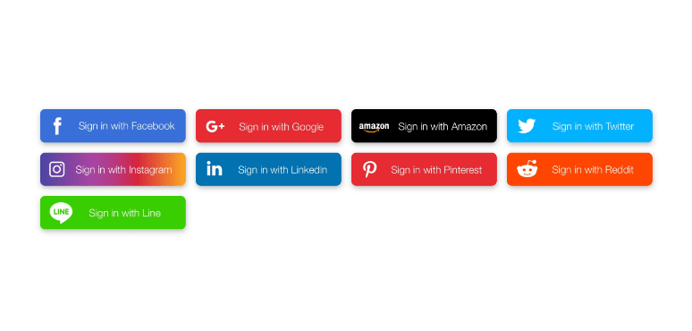
Login screen for pre-existing customer user.
In the future how
would you like to log-in?
This is the screen shown to an existing customer who have used their initial username and password to login.
This page will allow them to choose how they would like to login in the future.
They can either:
Login with a social media account
Create an account with an email and password
IF they choose to create username and password:
Rules:
Password must be at least 6 characters, be alphanumeric and contain 1 uppercase and 1 lowercase.
Email should auto populate based off previously provided information.
Verify password box does not appear until after password is entered.
Enter email for username
Create Password
Verify Password
Next

Slide 14
First Time User Sign In
Customer App

Slide 15
General information page and Terms of Service for new user (customer)
Please enter
information below
This is the screen shown to a new customer who does not have an account..
This page will allow them to enter relevant information to create an account. All information is required.
Rules:
All required fields must be entered.
Email must be confirmed on the backend. (no user involvement)
First Name
Last Name
Phone #
Email
Next

Slide 16
Terms of Service for new user (customer)
Please enter
information below
After customer clicks continue from the previous page, Terms of Service box will appear.
Rules:
Customer must scroll through 10% of TOS before swipe feature is interactive
Customer must swipe entire finger from left to right.
Add an animation once swipe function is complete
Terms of Service
First Name
Last Name
Phone #
Email
Swipe to agree>>>
Next

Slide 17
Login screen for new user (customer).
Create a username and password or connect social media account
This is the screen shown to a new customer who does not have an account..
This page will allow them to choose how they would like to create an account and log-in..
They can either:
Login with a social media account
Create an account with an email and password
IF they choose to create username and password:
Rules:
Password must be at least 6 characters, be alphanumeric and contain 1 uppercase and 1 lowercase
Email must be a valid email
Verify password box does not appear until after password is entered.
Enter email for username
Create Password
Verify Password
Next

Slide 18
END
User Authorization
Customer App

Slide 20
Customer App Walkthrough
Customer App

Slide 21





Initial customer home screen.
A.
Skip>>>
Good [time of day]
[Name]
This represents the initial home screen for all users on the customer side.
Elements:
Rules:
Welcome message
Reflects customers first name, time of day (morning, afternoon, evening)
Points
Points are generated by completing tasks which admin will generate on the backend in the dashboard
Discounts
Discount amounts are associated with points and given a value on the backend by admin in the dashboard
Progress Bar
Progress bar shows a customer where they are in comparison to where they can end up based off of accumulating points
34
Points
C.
B.
3%
Discount
D.
E.
Perks you can get with points
F.
Your next upcoming appointment is [date] at [time]
G.
New notification(s) about your upcoming appointment(s)
H.
Click here to check out The Home Team Deal of The Month!
I.

Slide 22
Initial customer home screen. (Continued)
A.
Skip>>>
Good [time of day]
[Name]
This represents the initial home screen for all users on the customer side.
Elements:
Rules (cont’d):
Welcome message
Points
Discounts
Progress Bar
Points & Rewards Program*
This is an accordion style menu that a customer can open and learn about activities they can complete to earn more points. Links to activities will be present in this box and generated by admin in the dashboard
Upcoming Appointments*
This will be a clickable element representing the next scheduled appointment. Upon clicking it will open up the appointment details
Notifications*
Anytime an appointment update or request is made customer will receive notification in home page. It will open up a temporary notification page where a customer can view and approve/deny appointment updates.
34
Points
C.
B.
3%
Discount
D.
E.
Points add up to rewards! (click for details)
F.
Your next upcoming appointment is [date] at [time]
G.
New notification(s) about your upcoming appointment(s)
H.
Click here to check out The Home Team Deal of The Month!
I.

Slide 23
Initial customer home screen. (Continued)
A.
Skip>>>
Good [time of day]
[Name]
This represents the initial home screen for all users on the customer side.
Elements:
Rules (cont’d):
Welcome message
Points
Discounts
Progress Bar
Discount Details
Upcoming Appointments
Notifications
Specials*
These will be messages with links to special deals and offers through our website. Deals and offers will be created within dashboard by admin.
Navigation Bar*
The navigation bar will allow user to navigate to different relevant screens throughout the app
34
Points
C.
B.
3%
Discount
D.
E.
Perks you can get with points
F.
Your next upcoming appointment is [date] at [time]
G.
New notification(s) about your upcoming appointment(s)
H.
Click here to check out The Home Team Deal of The Month!
I.

Slide 24
Initial customer home screen. (Continued)
Skip>>>
Good [time of day]
[Name]
This represents the initial home screen for all users on the customer side.
Elements:
Rules (cont’d):
Welcome message
Points
Discounts
Progress Bar
Discount Details
Upcoming Appointments
Notifications
Specials*
These will be messages with links to special deals and offers through our website. Deals and offers will be created within dashboard by admin.
Navigation Bar*
The navigation bar will allow user to navigate to different relevant screens throughout the app
34
Points
3%
Discount
Perks you can get with points
Your next upcoming appointment is [date] at [time]
New notification(s) about your upcoming appointment(s)
Click here to check out The Home Team Deal of The Month!

Slide 25
E. Points & Rewards Feature
Customer App

Slide 26
Points & Rewards program in customer app
Skip>>>
Good [time of day]
[Name]
This explains and shows the points feature module in the dashboard of the customer app.
The module is accordion style, so when the plus button is clicked, an accordion style menu opens up revealing current ways a customer can get more points, as well as what those points will earn them.
They will also be able to see tasks/ points earned over the past 30 days.
The initiatives will be in text format with hyperlinks to sources which will enable them to complete certain tasks
Initiatives, and their hyperlinks will be assigned in the dashboard and will be specific to:
A location
A type of customer profile
An individual
34
Points
3%
Discount
Perks you can get with points
• Complete Home Team App Tutorial - 25 Points
• Complete your Customer Profile - 50 Points
• Sign-Up for The Home Team Newsletter - 30 Points
Your next upcoming appointment is [date] at [time]

Slide 27
Points & Rewards Program in Dashboard
In Dashboard Admin must be able to create and send out notifications for Points & Rewards program to both customers and team members.
These will be the necessary inputs to create and send a points & rewards program:
Location
Choose which location will receive points and rewards offer
User Type
Customer
Team Member
User Role
Customer
Active
Inactive
Incomplete
Team Member
Prospect
Rookie
Starter
All-Star
Veteran
Legend
Points assigned
Number of points for offer
Text
What will the offer say in the app
Hyperlinks
Hyperlink (to app or website) to click within app and complete task
+ New Appointment
New Tasks
Notifications
Calendars
Members
Customers
Locations
Rewards Program
Reporting
Real-Time Dashboard

Slide 28
F. Upcoming Appointment Module
Customer App

Slide 29
Upcoming appointment module
Skip>>>
Good [time of day]
[Name]
In the home screen of the customer app, they will be able to see a module which represents their next upcoming appointment.
Upon clicking that module, the customer will be taken inside the next upcoming appointment where they can manage their appointment details.
34
Points
3%
Discount
Perks you can get with points
Your next upcoming appointment is [date] at [time]
New notification(s) about your upcoming appointment(s)
Click here to check out The Home Team Deal of The Month!

Slide 30

Upcoming appointment module
Image of Home OR Map Location
Once a customer clicks their upcoming appointment, it will take them inside of that appointment where they can edit and update details.
Service Type
Load / Unload
Start-End Time
Team Leader
Message / Call
Date
Start Time - Est Finish Time
Service Type
Job Size
Customer Name
Customer #
Address
Edit
Additional Details
Team Member Name
Team Member Name
See Bio
See Bio
Resources

Slide 31
G.Notifications for Upcoming Appointments
Customer App

Slide 32
Appointment Notifications
Skip>>>
Good [time of day]
[Name]
Whenever there are relevant appointment updates, a module will appear indicating such to the customer. Upon clicking the module customer will be taken to the notifications page
34
Points
3%
Discount
Perks you can get with points
Your next upcoming appointment is [date] at [time]
New notification(s) about your upcoming appointment(s)
Click here to check out The Home Team Deal of The Month!

Slide 33
Notifications Page
Notifications
[Team Member name] has requested to change appointment time from [time] to [time]
Once a customer clicks the notifications module, they will be taken to the notifications page.
[Team Member name] has sent you a new message
Special rewards perk 50 Points to complete your user profile

Slide 34
H. Home Team Special Offers
Customer App

Slide 35
Home Team Deals Module
Skip>>>
Good [time of day]
[Name]
Whenever The Home Team offers specials or discounts, a module will appear in the dashboard. Upon clicking that module it will open up a discount code they can use for a specific service
34
Points
3%
Discount
Perks you can get with points
Your next upcoming appointment is [date] at [time]
New notification(s) about your upcoming appointment(s)
Click here to check out The Home Team Deal of The Month!

Slide 36
Home Team Deals Module
Skip>>>
Good [time of day]
[Name]
Upon clicking that module it will open up a discount code they can use for a specific service
34
Points
3%
Discount
Perks you can get with points
Your next upcoming appointment is [date] at [time]
Click here to check out The Home Team Deal of The Month!
Use discount code “HomeTeam19” for 10% off your next service!

Slide 37
I. Navigation Bar
Customer App

Slide 38
Navigation Bar
Skip>>>
Good [time of day]
[Name]
The navigation bar is how customers will move from page to page throughout the app. The navigation bar consists of 5 components:
The Home Screen
Appointments
New Appointment
Notifications
User Profile
The following slides will show the initial screen for all pages.
34
Points
3%
Discount
Perks you can get with points
Your next upcoming appointment is [date] at [time]
New notification(s) about your upcoming appointment(s)
Click here to check out The Home Team Deal of The Month!
1.
2.
3.
4.
5.

Slide 39
Home Page
Customer App

Slide 40
Home Page
Skip>>>
Good [time of day]
[Name]
This will be the home page of the app. It will also act as a dashboard where customers can receive relevant updates/notifications and take action
34
Points
3%
Discount
Perks you can get with points
Your next upcoming appointment is [date] at [time]
New notification(s) about your upcoming appointment(s)
Click here to check out The Home Team Deal of The Month!

Slide 41
2. Appointments Page
Customer App

Slide 42
Upcoming Appointments Page
Upcoming Appointments Past Appointments
M T W T F S S
12 13 14 15 16 17 18
On this page customers are able to see their appointments. There are two views:
Upcoming Appointment
Past Appointments
Upcoming Appointments
The upcoming appointment is always the first view to populate. Appointments will be in order from most upcoming to future. User is able to scroll through appointments, and click an appointment to open up a new page, revealing appointment details.
September 17th
Image of Home OR Map Location
Service Type
Load / Unload, 3 Rooms... see more...
Start-End Time
Team Leader
Message / Call
October 17th
Image of Home OR Map Location
Service Type
Load / Unload, 3 Rooms... see more...
Start-End Time
Team Members

Slide 43
Upcoming Appointments Page
Upcoming Appointments Past Appointments
M T W T F S S
12 13 14 15 16 17 18
On this page customers are able to see their appointments. There are two views:
Upcoming Appointment
Past Appointments
Upcoming Appointments
The upcoming appointment is always the first view to populate. Appointments will be in order from most upcoming to future. User is able to scroll through appointments, and click an appointment to open up a new page, revealing appointment details.
September 17th
You have no upcoming appointments

Slide 44
Inside an Appointment
Customer App

Slide 45
Inside an Upcoming Appointment
Image of Home OR Map Location
Upon clicking an appointment it will open so user can see all details related to appointment.
Upon scrolling they will see an option to add images to their appointment as well
Interactive elements within the appointment:
Team Leader Icon
A pop up opens with team members bio and the option to message / call team member
General Appointment Details (Greyed Box)
A pop up opens with capability for customer to edit all relevant appointment details and save
Additional Details
An accordion style menu opens with additional details.
Team Member Icons
A pop up opens with team member bio
Resources (module never moves)
A resources page opens with additional customer resources
Add images icons (see next page)
Customer can add relevant images to their appointment
Service Type
Load / Unload
Start-End Time
Team Leader
Message / Call
Date
Start Time - Est Finish Time
Service Type
Job Size
Customer Name
Customer #
Address
Edit
Additional Details
Team Member Name
Team Member Name
See Bio
See Bio
Resources

Slide 46
Inside an Upcoming Appointment (Continued)
Image of Home OR Map Location
Service Type
Load / Unload
At the bottom of the page, the user can add images related to their appointment. By clicking the image icon.
Start-End Time
Team Leader
Message / Call
Date
Start Time - Est Finish Time
Service Type
Job Size
Customer Name
Customer #
Address
Additional Details
Team Member Name
Team Member Name
See Bio
See Bio
image
Add
image
add
image
Resources

Slide 47
Contact Team Leader

Slide 48
Team Leader Icon selection
Image of Home OR Map Location
When a customer selects the team member icon, a pop-up should appear as the following slide demonstrates.
Service Type
Load / Unload
Start-End Time
Team Leader
Message / Call
Date
Start Time - Est Finish Time
Service Type
Job Size
Customer Name
Customer #
Address
Edit
Additional Details
Team Member Name
Team Member Name
See Bio
See Bio
Resources

Slide 49


Team Leader Icon selection
Image of Home OR Map Location
The following screen illustrates a draft of the team leader pop-up
Upon hitting “Call” they will be initiated to call the team member through their mobile device.
Upon selecting “message” they will be taken to a chat thread which can also be found within the resources page.
First Name,
Last Name
Team Leader
Service Type
Start-End Time
Team Leader
Message / Call
Hi I am a student at [University] studying [Major]. I enjoy [Activity 1] & [Activity 2] My goal while with The Home Team is to [#1 Goal]
I’m here to help so give me a call anytime!
Load / Unload
Start-End Time
Team Leader
Message / Call
Edit
Date
Start Time - Est Finish Time
Service Type
Job Size
Customer Name
Customer #
Address
Member Since
Avg. Star Rating %
Jobs Completed #
Edit
Call
Message
First Name,
Last Name
Crew Member
Team Member Name
Team Member Name
Hi I am a student at [University] studying [Major]. I enjoy [Activity 1] & [Activity 2] My goal while with The Home Team is to [#1 Goal]
I’m here to help so give me a call anytime!
Additional Details
Team Member Name
Team Member Name
Member Since
Avg. Star Rating %
Jobs Completed #
See Bio
See Bio
Resources

Slide 50
Editing Appointment Details

Slide 51
Editing Appointment Details
Image of Home OR Map Location
A user can edit their appointment details by clicking the “edit” button in the box. Upon clicking the edit button a new window will open with their appointment details in an editable format.
Service Type
Load / Unload
Start-End Time
Team Leader
Message / Call
Date
Start Time - Est Finish Time
Service Type
Job Size
Customer Name
Customer #
Address
Edit
Additional Details
Team Member Name
Team Member Name
See Bio
See Bio
Resources

Slide 52
Editing Appointment Details
Date
________________________
Start Time
________________________
Crew Size
________________________
Hours Needed
________________________
Service Type
________________________
Job Size
________________________
Customer Name
________________________
Customer #
________________________
Address #1
________________________
Appointment Details
<<<Back
Image of Home OR Map Location
We understand things come up, would you like to reschedule?
This page represents where a customer can edit their appointment details. Page should have information from left to right in editable format. Customer can click an area, edit and confirm edit of details by saving.
Service Type
Load / Unload
Start-End Time
Team Leader
Message / Call
Date
Start Time - Est Finish Time
Service Type
Job Size
Customer Name
Customer #
Address
Edit
Yes
No, Cancel
Additional Details
Team Member Name
Team Member Name
See Bio
See Bio
Resources
Need to cancel? Click here.
Save

Slide 53
Editing Appointment Details
Date
________________________
Start Time
________________________
Crew Size
________________________
Hours Needed
________________________
Service Type
________________________
Job Size
________________________
Customer Name
________________________
Customer #
________________________
Address #1
________________________
Appointment Details
<<<Back
Image of Home OR Map Location
We understand things come up, would you like to reschedule?
This page represents where a customer can edit their appointment details. Page should have information from left to right in editable format. Customer can click an area, edit and confirm edit of details by saving.
Service Type
Load / Unload
Start-End Time
Team Leader
Message / Call
Date
Start Time - Est Finish Time
Service Type
Job Size
Customer Name
Customer #
Address
Edit
Yes
No, Cancel
Additional Details
Team Member Name
Team Member Name
See Bio
See Bio
Resources
Need to cancel? Click here.
Save

Slide 54
Editing Appointment Details
Date
________________________
Start Time
________________________
Crew Size
________________________
Hours Needed
________________________
Service Type
________________________
Job Size
________________________
Customer Name
________________________
Customer #
________________________
Address #1
________________________
Appointment Details
<<<Back
Image of Home OR Map Location
We really would love to work with you. We’d like to offer you an additional 5% off to let us help.
This page represents where a customer can edit their appointment details. Page should have information from left to right in editable format. Customer can click an area, edit and confirm edit of details by saving.
Service Type
Load / Unload
Start-End Time
Team Leader
Message / Call
Date
Start Time - Est Finish Time
Service Type
Job Size
Customer Name
Customer #
Address
Edit
Additional Details
Yes
No, thanks cancel
Team Member Name
Team Member Name
See Bio
See Bio
Resources
Need to cancel? Click here.
Save

Slide 55
Editing Appointment Details
Date
________________________
Start Time
________________________
Crew Size
________________________
Hours Needed
________________________
Service Type
________________________
Job Size
________________________
Customer Name
________________________
Customer #
________________________
Address #1
________________________
Appointment Details
<<<Back
Image of Home OR Map Location
What is your reason for cancelling?
Found a better price
Change of plans
Help from friends and family
No longer need service
Desired time not available
Other
This page represents where a customer can edit their appointment details. Page should have information from left to right in editable format. Customer can click an area, edit and confirm edit of details by saving.
Service Type
Load / Unload
Start-End Time
Team Leader
Message / Call
Date
Start Time - Est Finish Time
Service Type
Job Size
Customer Name
Customer #
Address
Edit
Additional Details
Team Member Name
Team Member Name
Submit
See Bio
See Bio
Resources
Need to cancel? Click here.
Save

Slide 56
Editing Appointment Details
Date
________________________
Start Time
________________________
Crew Size
________________________
Hours Needed
________________________
Service Type
________________________
Job Size
________________________
Customer Name
________________________
Customer #
________________________
Address #1
________________________
Appointment Details
<<<Back
Image of Home OR Map Location
Please swipe the bar from left to right to confirm cancel
This page represents where a customer can edit their appointment details. Page should have information from left to right in editable format. Customer can click an area, edit and confirm edit of details by saving.
Service Type
Load / Unload
Start-End Time
Team Leader
Message / Call
Date
Start Time - Est Finish Time
Service Type
Job Size
Customer Name
Customer #
Address
Edit
Additional Details
Team Member Name
Team Member Name
See Bio
See Bio
Keep my appointment
Resources
Need to cancel? Click here.
Save

Slide 57
Editing Appointment Details
Date
________________________
Start Time
________________________
Crew Size
________________________
Hours Needed
________________________
Service Type
________________________
Job Size
________________________
Customer Name
________________________
Customer #
________________________
Address #1
________________________
Appointment Details
<<<Back
Image of Home OR Map Location
[name] Your appointment was successfully cancelled
We’re sad to see you go. Hope everything works out! As a parting gift use code “HT2019” for 10% off any future services!
All the best!
This page represents where a customer can edit their appointment details. Page should have information from left to right in editable format. Customer can click an area, edit and confirm edit of details by saving.
Service Type
Load / Unload
Start-End Time
Team Leader
Message / Call
Date
Start Time - Est Finish Time
Service Type
Job Size
Customer Name
Customer #
Address
Edit
Additional Details
Team Member Name
Team Member Name
ok
See Bio
See Bio
Resources
Need to cancel? Click here.
Save

Slide 58
Editing Appointment Details
Date
________________________
Start Time
________________________
Crew Size
________________________
Hours Needed
________________________
Service Type
________________________
Job Size
________________________
Customer Name
________________________
Customer #
________________________
Address #1
________________________
Appointment Details
<<<Back
Image of Home OR Map Location
[name] we’ve successfully applied a X% discount to your appointment. If you still need to reschedule please do so on the following page.
All the best!
The Home Team
This page represents where a customer can edit their appointment details. Page should have information from left to right in editable format. Customer can click an area, edit and confirm edit of details by saving.
Service Type
Load / Unload
Start-End Time
Team Leader
Message / Call
Date
Start Time - Est Finish Time
Service Type
Job Size
Customer Name
Customer #
Address
Edit
Additional Details
Team Member Name
Team Member Name
ok
See Bio
See Bio
Resources
Need to cancel? Click here.
Save

Slide 59
Editing Appointment Details
Message to The Team
________________________
Parking Instructions
________________________
Security / Gate Instructions
________________________
Pets
________________________
Stairs
________________________
Elevators
________________________
Additional Appointment
Details
<<<Back
Image of Home OR Map Location
This page represents where a customer can edit their appointment details. Page should have information from left to right in editable format. Customer can click an area, edit and confirm edit of details by saving.
Service Type
Load / Unload
Start-End Time
Team Leader
Message / Call
Date
Start Time - Est Finish Time
Service Type
Job Size
Customer Name
Customer #
Address
Edit
Additional Details
Team Member Name
Team Member Name
See Bio
See Bio
Resources
Save

Slide 60
Viewing & Editing Additional Appointment Details

Slide 61
Viewing Additional Appointment Details
Image of Home OR Map Location
A user can view their additional appointment details by clicking the “plus” button to the right. Upon clicking the plus button an accordion style menu will open revealing their additional details.
Service Type
Load / Unload
Start-End Time
Team Leader
Message / Call
Date
Start Time - Est Finish Time
Service Type
Job Size
Customer Name
Customer #
Address
Edit
Additional Details
Team Member Name
Team Member Name
See Bio
See Bio
Resources

Slide 62
Editing Appointment Details
Message to The Team
Parking Instructions
Security / Gate Instructions
Pets
Stairs
Elevators
Appointment Details
<<<Back
Image of Home OR Map Location
Edit
This page represents where a customer can view edit their additional appointment details. Page should resemble that of the booking process for a customer.
Upon entering page it is “view only” mode. If user clicks edit then fields will be editable. Once edit is hit, save button will appear at the bottom.
Service Type
Load / Unload
Start-End Time
Team Leader
Message / Call
Date
Start Time - Est Finish Time
Service Type
Job Size
Customer Name
Customer #
Address
Edit
Additional Details
Team Member Name
Team Member Name
See Bio
See Bio
Resources
Save

Slide 63
Viewing Team Member Profile

Slide 64
Viewing team member profiles
Image of Home OR Map Location
A user can view team member profiles by clicking on a team member icon. Upon clicking on the icon it will open a pop-up that has all team members “starting with the one they clicked on and their bios.
Service Type
Load / Unload
Start-End Time
Team Leader
Message / Call
Date
Start Time - Est Finish Time
Service Type
Job Size
Customer Name
Customer #
Address
Edit
Additional Details
Team Member Name
Team Member Name
See Bio
See Bio
Resources

Slide 65
Viewing team member profiles
Image of Home OR Map Location
Upon clicking on a team members bio, a pop up will open showing all team members bio’s. A customer can scroll and see as many team members as there is.
First Name,
Last Name
Team Leader
Service Type
Start-End Time
Team Leader
Message / Call
Hi I am a student at [University] studying [Major]. I enjoy [Activity 1] & [Activity 2] My goal while with The Home Team is to [#1 Goal]
I’m here to help so give me a call anytime!
Load / Unload
Start-End Time
Team Leader
Message / Call
Edit
Date
Start Time - Est Finish Time
Service Type
Job Size
Customer Name
Customer #
Address
Member Since
Avg. Star Rating %
Jobs Completed #
Edit
Call
Message
First Name,
Last Name
Crew Member
Team Member Name
Team Member Name
Hi I am a student at [University] studying [Major]. I enjoy [Activity 1] & [Activity 2] My goal while with The Home Team is to [#1 Goal]
I’m here to help so give me a call anytime!
Additional Details
Team Member Name
Team Member Name
Member Since
Avg. Star Rating %
Jobs Completed #
See Bio
See Bio
Resources

Slide 66
Accessing & Viewing Resources Page

Slide 67
Resources
Image of Home OR Map Location
The resources link will take a customer to a page that offers additional resources to communicate with team leader, corporate and additional resources.
Service Type
Load / Unload
Start-End Time
Team Leader
Message / Call
Date
Start Time - Est Finish Time
Service Type
Job Size
Customer Name
Customer #
Address
Edit
Additional Details
Team Member Name
Team Member Name
See Bio
See Bio
Resources

Slide 68







Inside the resources page
Skip>>>
Inside the resources page will be additional links / pages for user to complete certain tasks. These resources will include:
Chat thread
Upload photos
Survey
FAQ’s
Support
Damage Report
Chat
Upload Photos
Survey
FAQ’s
Support
Damage report
<<< Back

Slide 69
Resources - Chat Thread

Slide 70
Accessing Chat Thread
Skip>>>
The chat thread allows a customer and team member to communicate directly within the app. Customer will click the indicated icon to open up the chat thread.
Chat
Upload Photos
Survey
FAQ’s
Support
Damage report
<<< Back

Slide 71
Inside the chat thread
<<< Back
Skip>>>
Blah blah hi, this time blah message
When a customer is inside the chat thread they can view and send messages directly to the team leader and crew members.
Rules:
Only Chief and Customer can participate in chat thread prior to day of appointment.
On the day of the appointment crew members can participate in chat thread
Crew members can see chat thread however, cannot participate
Chief and Customer receive push notifications when a new message is received
All chats are dated, time stamped and sender stamped
All chat activity is recorded and logged in the job profile located in the admin dashboard
Admin can access and participate in chat from within the admin dashboard
Chat thread is disabled as soon as the Chief clocks in
First Name Last Initial Date & Time
Blah blah hi, this time blah message
First Name Last Initial Date & Time
Blah blah hi, this time blah message
First Name Last Initial Date & Time
Blah blah hi, this time blah message
First Name Last Initial Date & Time
Blah blah hi, this time blah message
First Name Last Initial Date & Time
Type text here
Keyboard

Slide 72
Resources- Uploading Photos

Slide 73
Uploading photos of job-site activities
Skip>>>
Customer can upload multiple photos. Once a photo is uploaded customer must tag the photo to a certain category. They will then have option to leave comment. After submission they can then upload additional photos through same process
Rules:
Photo Tags:
Team Photo
Quality Work
Team at work
All photos are added to job profile in the dashboard
All activities are logged within dashboard activity log in job profile
Chat
Upload Photos
Survey
FAQ’s
Support
Damage report
<<< Back

Slide 74
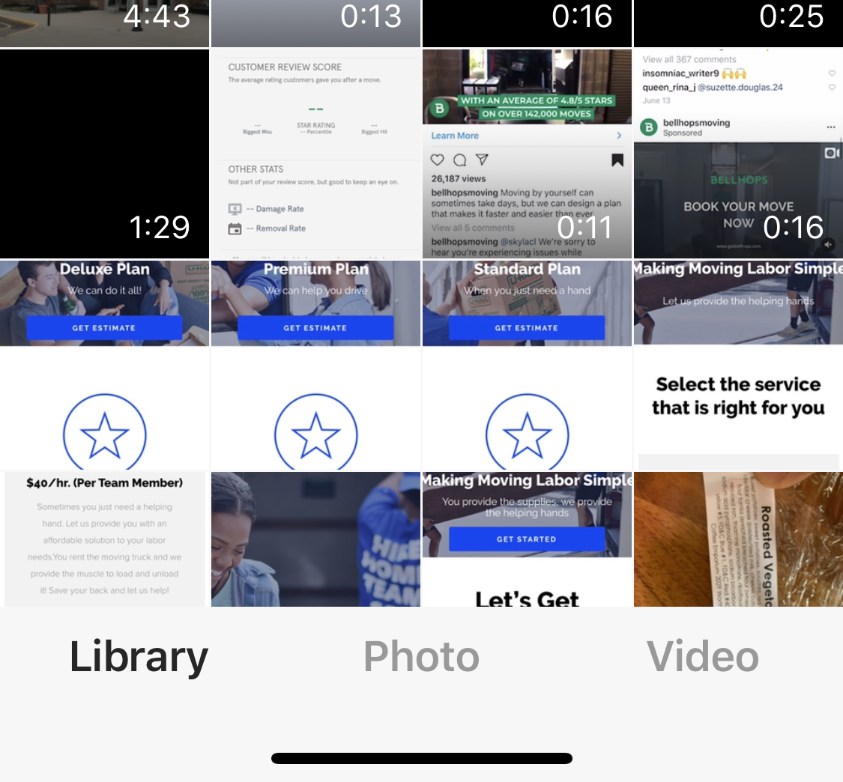
Uploading photos of job-site activities
Cancel
Next
Selected image shows up here
User will choose an image and click next

Slide 75
Damage Report Feature Completion
<<< Back
Skip>>>
Text recapping what happened
On this page, customer will view image details and text prior to submitting. Once customer reviews details they can hit submit and the report will be sent.
Rules:
Damage report will be sent and attached to the job profile
Report submission will be logged in the activity log
Admin receives a notification of new damage report in the dashboard
Edit
Images to scroll
Type details here...
Submit

Slide 76
Damage Report Feature Completion
<<< Back
Skip>>>
Post
Images to scroll
On this page, customer will view image details and text prior to submitting. Once customer reviews details they can hit submit and the report will be sent.
Rules:
Damage report will be sent and attached to the job profile
Report submission will be logged in the activity log
Admin receives a notification of new damage report in the dashboard
Your post was successful! (Thumbs Up Icon)
Write Caption
Add more images
Select Tags
Submit

Slide 77
Uploading photos of job-site activities
Back
Selected image shows up here
User will then write a caption and select a predetermined tag(s) to their posting
Write Caption
Select Tags
Post

Slide 78
Uploading photos of job-site activities
Skip>>>
Upload section for photos.
Customer can upload multiple photos. Once a photo is uploaded customer must tag the photo to a certain category. They will then have option to leave comment. After submission they can then upload additional photos through same process
Rules:
Photo Tags:
Team Photo
Quality Work
Team at work
All photos are added to job profile in the dashboard
All activities are logged within dashboard activity log in job profile
<<< Back

Slide 79
Resources - Survey

Slide 80
Accessing and completing customer survey
Skip>>>
Pre-job there will be a survey for customer to take. When clicking this link, it should open a webpage within the app to a typeform. The type form will have hidden fields so customer does not have to enter name or already know information.
Rules
If customer clicks link, activity is recorded in dashboard
If survey is complete points are accumulated and indicated discounts applied to the customer appointment and shown within dashboard
Chat
Upload Photos
Survey
FAQ’s
Support
Damage report
<<< Back

Slide 81
FAQs
Customer App

Slide 82
FAQ Option
Skip>>>
Customer can click FAQ’s at anytime. This will open webpage within app to our FAQ page from out marketing site.
Rules:
If customer clicks this link it is added to activity log
Notification is sent to admin via dashboard
Chat
Upload Photos
Survey
FAQ’s
Support
Damage report
<<< Back

Slide 83
Support
Customer App

Slide 84
Support Feature
Skip>>>
We will use a third party application for customers to communicate with our customer support team (zen desk). If customer support team is unavailable customer can choose to submit message via a “contact us” form or send a message in the chat and it will be responded to as soon as support is back online
Chat
Upload Photos
Survey
FAQ’s
Support
Damage report
<<< Back

Slide 85
Damage Report
Customer App

Slide 86
Damage Report Feature
Skip>>>
If there is ever damage on a job site, a customer can access a damage report form indicating what happened and submitting pictures as well.
Chat
Upload Photos
Survey
FAQ’s
Support
Damage report
<<< Back

Slide 87
Damage Report Feature Details
Skip>>>
We’re sorry for the inconvenience. Please submit a damage report and we will reach out within 24hrs.
Upon selecting the damage report option, customer will be able type in a message indicating what happened in a text field.
Upon typing the “next” option will appear for user to go on to the next prompt.
Please type what happened here
Next
<<< Back

Slide 88
Damage Report Feature Uploading Images
Skip>>>
On this page customers can upload as many images as necessary. Customers can then add comments to a picture prior to uploading it in order to detail damage related to the picture.
Please upload all relevant images
Next
<<< Back

Slide 89
Damage Report Feature Completion
Skip>>>
Text recapping what happened
On this page, customer will view image details and text prior to submitting. Once customer reviews details they can hit submit and the report will be sent.
Rules:
Damage report will be sent and attached to the job profile
Report submission will be logged in the activity log
Admin receives a notification of new damage report in the dashboard
Your report has been submitted. We apologize for the inconvenience. We will be in touch within 24hrs to make things right!
Edit
Images to scroll
Add more images
Submit
<<< Back

Slide 90
Past Appointments Page
Upcoming Appointments Past Appointments
M T W T F S S
12 13 14 15 16 17 18
2. Past Appointments Page
When in past appointment view the most recently completed appointment will be at the top.
This view will include all the same functionality as the previous view, however the shift will include historical information of the appointment including:
Amount Paid
Should reflect the total billed amount.
Review Option
If customer has not left a review, there should be a button that says “leave review”
If customer has left a review, star rating should be reflected in shift preview
Points Earned
Points earned are equivalent to the points system established for that location in the admin dashboard
August 17th
Completed
Complete
Amount Paid - 300 Points
Image of Home OR Map Location
Your Review
Service Type
Load / Unload, 3 Rooms... see more...
Start-End Time
Team Members
August 7th
Cancelled
Cancelled
Image of Home OR Map Location
Service Type
Load / Unload, 3 Rooms... see more...
Start-End Time
Team Members

Slide 91
END
2. Appointments Page
Customer App

Slide 92
3. New Appointment Page
Customer App

Slide 93
Home Page
Skip>>>
Good [time of day]
[Name]
This will be the home page of the app. It will also act as a dashboard where customers can receive relevant updates/notifications and take action
34
Points
3%
Discount
Perks you can get with points
Your next upcoming appointment is [date] at [time]
New notification(s) about your upcoming appointment(s)
Click here to check out The Home Team Deal of The Month!
1.
2.
3.
4.
5.

Slide 94
New Appointment Page
Click Here for On-Demand Help!
On this page user can request new appointment. There are two types of request:
On-Demand
Scheduled
An on-demand request means a user needs assistance immediately. Team members in the local area will be notified.
Scheduled requests will choose a service, date, time and provide greater detail regarding service requests.
Lift & Carry
Handy Services
Lawn Care
Home Cleaning

Slide 95
On-Demand Service Requests
Customer App

Slide 96
On-demand service request
What category do you need help in?
After selecting on demand service, customer will click the category in which they need help.
Lift & Carry
Handy Services
Lawn Care
Home Cleaning

Slide 97
On-demand service request (con’t)
What category do you need help in?
User will then type in details of request. This will act as “Job Description” when shift is created within the app for team members.
A new shift will be created and a request sent to team members with incomplete job details.
Please type a brief description of what you need help with below and we will send out your request!
Type here...
Lift & Carry
Handy Services
Team Members
1
Lawn Care
Home Cleaning
Send Request

Slide 98
On-demand service request (con’t)
What category do you need help in?
User will then see a confirmation message. Prompting them to fill out job details.
Congratulations your request has been sent. You will receive a notification once your request has been accepted. In the meantime please fill out the remaining details
Lift & Carry
Handy Services
Lawn Care
Home Cleaning
Continue

Slide 99
On-demand service request (con’t)
General Information
Customer will then complete additional job-details.
Address
Service Type
Job Description
Next

Slide 100
On-demand service request (con’t)
General Information Cont’d
Customer will then complete additional job-details.
Upon clicking submit TOS will populate.
Job Site Details
Additional Information
Payment Method
Submit

Slide 101
On-demand service request (con’t)
General Information Cont’d
Customer must swipe to agree to TOS.
Terms of Service
Job Site Details
Additional Information
Payment Method
Swipe to agree>>>
Submit

Slide 102
On-demand service request (con’t)
General Information Cont’d
User will see confirmation requests and appointment details will be updated in team member app
You’re all set! Your request has been sent!
Job Site Details
Additional Information
Payment Method
Submit

Slide 103
Scheduled Service Requests
Customer App

Slide 104
Scheduled service request
Click Here for On-Demand Help!
On this page user can request new appointment. There are two types of request:
On-Demand
Scheduled
An on-demand request means a user needs assistance immediately. Team members in the local area will be notified.
Scheduled requests will choose a service, date, time and provide greater detail regarding service requests.
Lift & Carry
Handy Services
Lawn Care
Home Cleaning

Slide 105
Scheduled service request (cont’d)
What category do you need help in?
After selecting a service category user will provide job details.
Service Type
Job Description
Date & Time
Address Information
Continue

Slide 106
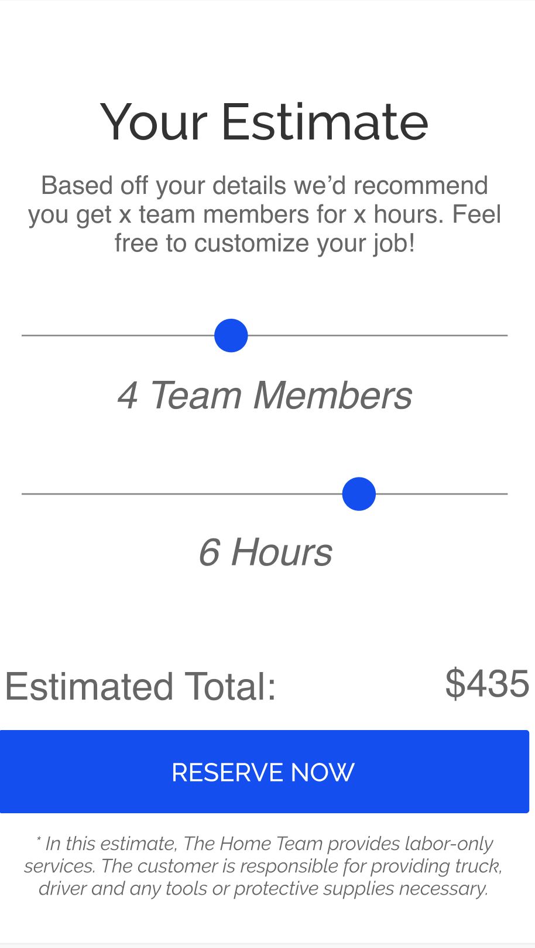
Scheduled service request (cont’d)
Estimate Page
Estimate page for user after submitting information.

Slide 107
Scheduled service request (cont’d)
What category do you need help in?
After submitting job details, customer will then complete additional details.
Customer Details
Job Site Details
Additional Information
Payment Details
Submit

Slide 108
Scheduled service request (cont’d)
You're all set [name] We have you down for a [date] at [time] to help you [service]. We’re excited to help. Be on the lookout for a confirmation email. Also please watch the following video for next steps
Once payment is complete, customer will see confirmation page
Confirmation Video

Slide 109
4. Notifications
Customer App

Slide 110
Notifications Page
Notifications
[Team Member name] has requested to change appointment time from [time] to [time]
On this page customers can view notifications from corporate and appointment updates from team members. By clicking the notification it will take them to either the appointment or a special page of offer.
[Team Member name] has sent you a new message
Special rewards perk 50 Points to complete your user profile

Slide 111
5. Profile Management
Customer App

Slide 112
Profile Page
First name
Last Name
From this page a customer can manage their profile, personal information and communicate with corporate.
Personal Information
Payment Information
Security Settings
Community Center
Get Help
Give Feedback
Terms of Service
Log Out

Slide 113
Personal Information
Customer App

Slide 114
Personal Information
First name
Last Name
Upon selecting “Personal Information” Screen will change for user to see their personal information. Upon hitting edit, all information becomes editable.
First Name
Last Name
Primary Email
Primary Phone #
Address
Bio
Edit

Slide 115
Personal Information
First name
Last Name
While editing personal information, the “edit” button changes to “save”. Once customer is done editing, they select save and page goes to original view.
First Name
Last Name
Primary Email
Primary Phone #
Address
Bio
Save

Slide 116
Payment Information
Customer App

Slide 117
Payment Information
First name
Last Name
Upon selecting “Payment Information” Screen will change for user to see their payment information. User will be able to see saved payment information as well as add up to 2 additional payment methods.
XXXX-XXXX-XXXX-0765
Primary Payment Method
Edit
Add New Payment Method

Slide 118
Payment Information
First name
Last Name
When adding a new payment method, customer will enter the following information, and then press save. Once saved, payment method will be added during check-outs
XXXX-XXXX-XXXX-0765
Primary Payment Method
Edit
Add New Payment Method
Enter Card Number
Exp. Date
CVV
Billing Zip
Save

Slide 119
Security Settings
Customer App

Slide 120
Payment Information
First name
Last Name
On this page customer can update current password to new password. Once they click the update password option they can enter and update new password information.
Update Password

Slide 121
Payment Information
First name
Last Name
On this page customer can update current password to new password.
Rules:
Must enter old password first
New password must be alphanumeric and contain one uppercase and one special character
Must enter exact same password in confirm section to confirm new password
Current Password
New Password
Confirm New Password
Save

Slide 122
Community Center
Customer App

Slide 123

Community Center
Community Center
City
City
Image
Tag
On this page customers will be able to see and engage with Home Team posts by other customers and team members.
Image
Tag
Like
Likes 18
Caption
Comment
Like
Likes 18
View Comments
Comment
City
Report
View Comments
City
Image
Tag
Image
Tag
Like
Likes 18
Caption
Comment
Like
Likes 18
View Comments
Comment
View Comments

Slide 124
Community Feed Posting Process
Cancel
Next
Selected image shows up here
User will choose an image and click next

Slide 125
Community Feed
Back
Selected image shows up here
User will then write a caption and select a predetermined tag(s) to their posting
Write Caption
Select Tags
Post

Slide 126
Get Help
Customer App

Slide 127
Get Help
<<< Back
Skip>>>
Blah blah hi, this time blah message
The Get Help page will take a customer to a live chat page if available. If not, customer will be taken to a general “contact us” page where they can submit their inquiry. There will also be a link to our FAQs page found on our website.
First Name Last Initial Date & Time
Blah blah hi, this time blah message
First Name Last Initial Date & Time
Blah blah hi, this time blah message
First Name Last Initial Date & Time
Blah blah hi, this time blah message
First Name Last Initial Date & Time
Blah blah hi, this time blah message
First Name Last Initial Date & Time
Type text here
Keyboard

Slide 128
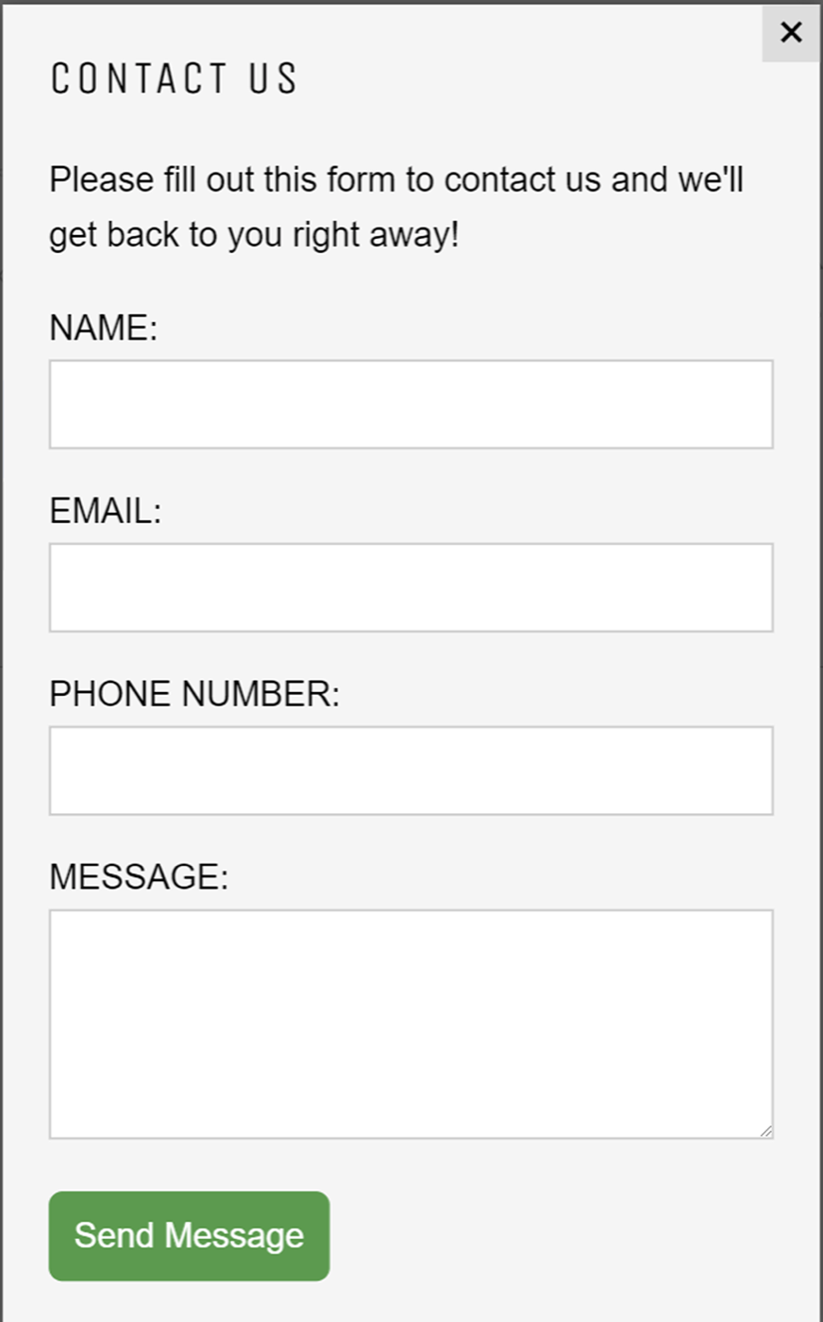
Get Help
The Get Help page will take a customer to a live chat page if available. If not, customer will be taken to a general “contact us” page where they can submit their inquiry. There will also be a link to our FAQs page found on our website.
FAQs

Slide 129
Feedback
Customer App

Slide 130
Feedback Page
First name
Last Name
When a user selects the feedback option, a typeform will populate within the app.
Personal Information
Payment Information
Security Settings
Community Center
Get Help
Give Feedback
Terms of Service
Log Out

Slide 131
END
Customer App Walkthrough
Customer App

Slide 132
User Tutorial: Pre-existing Customer
Customer App

Slide 133
1st Time login, pre-existing customer tutorial.
Skip>>>
Good [time of day]
[Name]
This flow will outline the tutorial process of a first time user with a pre-existing appointment.
Rules:
34
Points
3%
Discount
This is the home screen! Your upcoming appointment can be found here. Click to see details!
Discounts you can get with points
Your next upcoming appointment is [date] at [time]

